Slide 1
UTTING RESEARCH
The One Nation
Voter Study
A national survey of 1,014 One Nation voters
August 2026 · Prepared by JS Utting
john@uttingresearch.com
Tel 0414 428 846
V200826

Slide 2
What is in this report
1
Who votes One Nation
8
The One Nation platform
2
The country, as they see it
9
Pauline Hanson
3
Support for One Nation
10
Trump and Barnaby Joyce
4
The parties and the leaders
11
One Nation in government
5
Labor and the Prime Minister
12
The bottom line
6
The Liberals and Angus Taylor
13
Where they get their news
7
The Nationals and Matt Canavan
One Nation Voter Study
2

Slide 3
About this research
Who we spoke to
When and how
1,014 Australians who say they would vote One Nation at a federal election, drawn from a wider survey of 5,043 people.
7–12 August 2026, online, respondents completing the survey themselves.
Adjusting the results
How precise
Results are adjusted to better reflect the One Nation voting population, benchmarked against Australian Electoral Commission enrolment figures. No adjustment is made for gender; the sample is 62% male.
Results are accurate to within roughly 4 percentage points. Figures based on small groups are marked with an asterisk and should be read as indicative only.
In their own words
Question order
Several questions were open-ended. Answers were grouped into themes by keyword. One answer can raise several themes, so those figures do not add to 100.
The final voting-intention question was asked after respondents had reviewed criticisms of Pauline Hanson — a deliberate stress test of loyalty, not a normal polling question.
One Nation Voter Study
3

Slide 4
In short
One Nation voters are reacting to two issues above all others — immigration and the cost of living — and the failure of the major parties to deal with them. But this is no longer a conventional protest vote it, has become considerably more entrenched.
One Nation’s rise is as much a story of Liberal failure as of One Nation success. Immigration and the cost of living created the conditions. Labor is overwhelmingly rejected by these voters, and the Liberals have not offered them a convincing alternative.
One Nation Voter Study
4

Slide 5
PART 1
Who votes One Nation
A portrait of the 1,014 voters in this survey
One Nation Voter Study
5

Slide 6
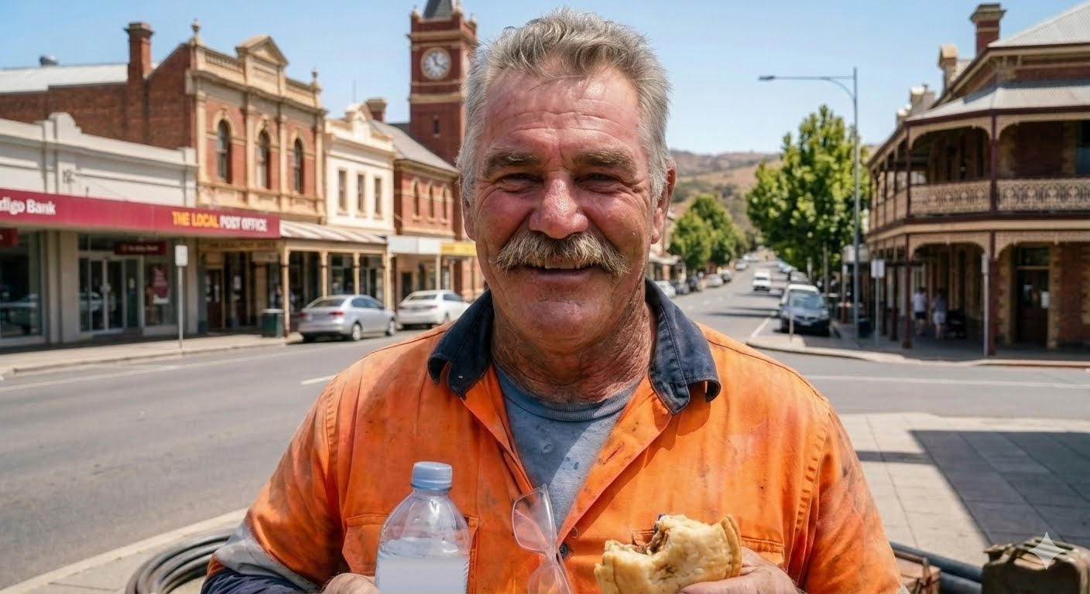






PART 1 · WHO VOTES ONE NATION
A quick pic.
He is in his late fifties and lives outside a capital city. He owns his home — most often outright — and he still gets up and goes to work. He did a trade or a TAFE diploma rather than a degree, speaks only English at home, and calls his background Australian. This is not a portrait of the fringe. It is a portrait of the part of Australia that used to be called the mainstream.
Only one voter in six is under 35, and only one in five rents.
62%
are men
56%
are aged 50 or over
55%
live outside a capital
38% are women
49% of all Australians
44% of all Australians
77%
own their own home
43%
hold a trade or diploma
88%
speak only English
67% of all Australians
31% of all Australians
72% of all Australians
One Nation Voter Study
Survey of 1,014 One Nation voters, 7–12 August 2026, adjusted for age.
6

Slide 7
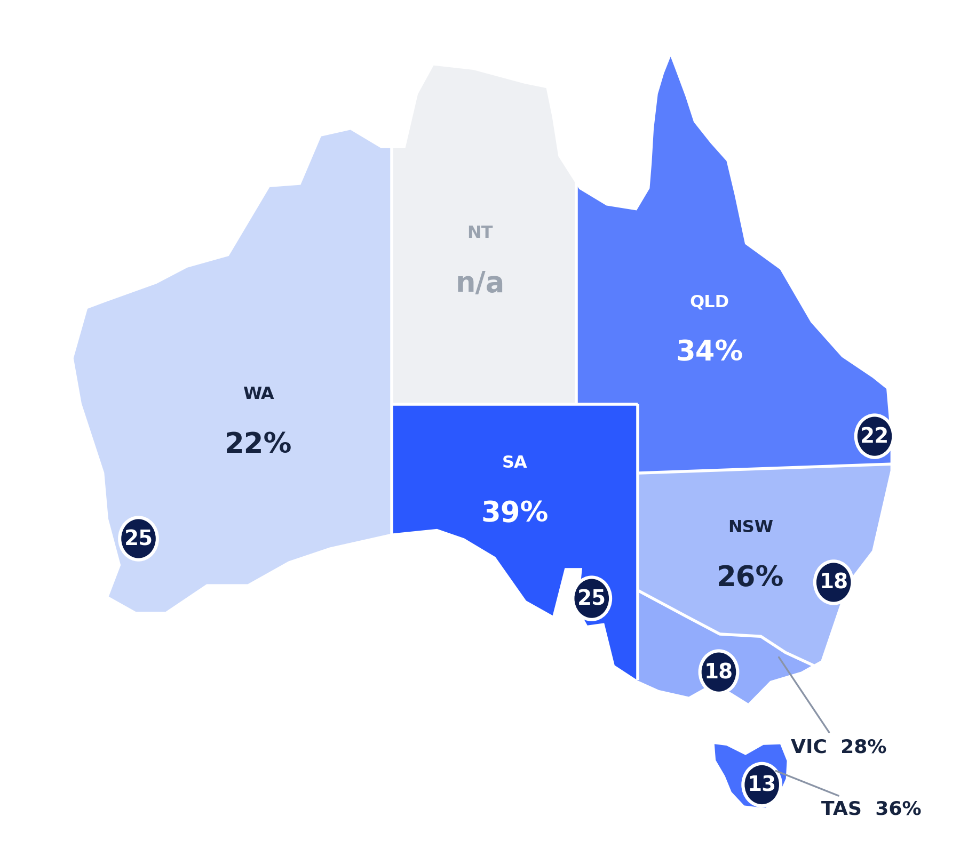




PART 1 · WHO VOTES ONE NATION
The further from a capital, the stronger the vote
Q. If a federal election were held today for the House of Representatives, which party would you vote for? · Postcode.
And it is not about state borders — it is about size of place
Major city
20%
Regional city
27%
Small town
32%
Rural / remote
31%
Support climbs steeply the moment you leave the cities — and then flattens. A small town and a rural district vote the same way.
55% live outside a capital city — against 44% of all Australians.
Capital city
Rest of the state — darker is stronger
One Nation Voter Study
Asked of 5,043 Australian voters; national figure 23%. Northern Territory not separately measured.
7

Slide 8
Older than the country as a whole.
Q. Which of these age groups are you in?
56%
18–24
8%
25–34
9%
are aged 50 or over
35–49
27%
Against 49% of all Australian adults. Only one voter in six is under 35.
50–64
28%
65 and over
28%
One Nation Voter Study
7

Slide 9
And more male.
Q. Are you male or female?
62%
Male
62%
of One Nation voters are men
Female
38%
The gender gap is one of the clearest features of this survey.
One Nation Voter Study
8

Slide 10
They own their homes.
Q. Which best describes your housing situation?
77%
Own outright
42%
Own with a mortgage
35%
own their own home
Renting
17%
Against 67% of Australians generally. Just 17% rent.
Other
6%
One Nation Voter Study
9

Slide 11
Most are still working.
Q. Which best describes your current employment situation?
61%
Working full-time
43%
Part-time or casual
11%
are in work of some kind
Self-employed
6%
Against 64% of Australians generally. Fewer than a third are retired — this is a working population, not a retired one.
Retired
30%
One Nation Voter Study
10

Slide 12
One Nation Performance on a State Basis
Q. If a federal election were held today for the House of Representatives, which party would you vote for? Asked of 5,043 Australian voters.
national 23%
Queensland
n=950
27%
South Australia
n=457
27%
Western Australia
n=542
24%
Tasmania
n=164
23%
New South Wales
n=1,482
20%
Victoria
n=1,266
20%
One Nation Voter Study
12

Slide 13
Geographic Distribution of One Nation Vote
Q. If a federal election were held today, which party would you vote for? Asked of 5,043 Australian voters. National figure 23%.
BY SIZE OF PLACE
CAPITAL CITY AGAINST THE REST OF THE STATE
Capital
Rest of state
Major city
n=3,598
20%
Queensland
22%
34%
Regional city
n=593
27%
South Australia*
25%
39%
Small town
n=373
32%
Victoria
18%
28%
Rural / remote
n=479
31%
New South Wales
18%
26%
Western Australia*
25%
Support climbs steeply out of the cities, then flattens. Small towns and rural areas are the same.
22%
Tasmania*
13%
36%
.
One Nation Voter Study
13

Slide 14
55% of One Nation voters live outside the capital cities — against 44% of all Australians.
Q. What is your postcode? (Postcodes matched to federal electorates.)
ONE NATION
ALL AUSTRALIANS
Inner metropolitan
21%
27%
Outer metropolitan
24%
29%
Provincial
23%
17%
Rural
32%
27%
.
One Nation Voter Study
13

Slide 15
Overwhelmingly Anglo-Australian.
Q. Do you speak a language other than English at home? · Which background do you most identify with?
88%
77%
speak only English at home
identify their background as Australian
Against 72% of Australians generally.
Non-European backgrounds run at about 4% of this sample, against roughly 20% of the population.
One Nation Voter Study
14

Slide 16
More Christian — and barely anything else.
Q. What is your religion, if any?
ONE NATION
ALL AUSTRALIANS
No religion
33%
39%
Catholic
24%
20%
Anglican
17%
10%
Other Christian
18%
14%
Islam
1%
3%
Hinduism
<1%
3%
Buddhism
1%
2%
Survey of 1,014 One Nation voters, 7–12 August 2026, adjusted for age. National figures: ABS Census 2021, all persons. Survey figures are adults only; affiliation runs higher among older Australians, so part of the difference reflects age.
One Nation Voter Study
15

Slide 17
Tradies are the heartland of One Nation support .
Q. What is the highest level of education you have completed?
ONE NATION
ALL AUSTRALIANS
Trade certificate, certificate or diploma
43%
31%
Bachelor degree or higher
28%
29%
Year 12 or below, no post-school qualification
29%
40%
43% hold a trade, certificate or diploma — twelve points above the national rate.
One Nation Voter Study
16

Slide 18
Household Income— in the middle and squeezed.
67% say finances have gone backwards.
Share of One Nation voters in each quintile
24%
22%
22%
grey line = 20%, an even spread
17%
15%
Lowest fifth
Second fifth
Middle fifth
Fourth fifth
Top fifth
under $60,000
$60,000–$90,000
$90,000–$130,000
$130,000–$195,000
over $195,000
A typical One Nation household
A typical Australian household
about $101,000 a year
about $109,000 a year
One Nation Voter Study
17

Slide 19
More Unhappy
Q. Taking all things together, how happy would you say you are these days?
36%
1
THE FULL PICTURE
v
22%
One Nation voters, with all Australians in grey
Very happy
10%
18%
of One Nation voters
say they are not happy
of all Australians
say the same
Quite happy
53%
60%
Not very happy
29%
17%
"IM FED UP SAYING WHAT IM NOT HAPPY WITH! COST OF LIVING COST OF FUEL COST OF POWER COST OF MORTGAGES EVERYTHING HAS GONE UP AT CRAZY PRICES.!!!!!!!!!!!!! I BET OUR WONDERFUL PM ISN'T STRUGGLING!!!!!!!!!!!!!!!!"
— Woman, 65+, Greater Perth
Not at all happy
7%
5%
AND IT IS DRIVEN BY MONEY
58%
of those whose finances
have gone backwards a lot
15%
of those whose finances
are the same or better
⁽¹⁾ IPSOS 2026
One Nation Voter Study
18

Slide 20

PART 1 · WHO VOTES ONE NATION
Most of this vote came over from the Liberals
Q. At the last federal election on 3 May 2025, who did you vote for in the House of Representatives?
NEW SINCE THE 2025 ELECTION — 70%
ONE
NATION
2026
Liberal / National
38%
70%
Labor
17%
of today's One Nation voters backed another party in 2025 — or did not vote at all.
Did not vote / can't recall
9%
Minor party / independent
6%
Only three in ten were with One Nation at the last election. The rest have arrived in the fifteen months since — and the single largest group crossed over from the Liberal Party.
ALREADY WITH ONE NATION — 30%
One Nation
30%
This is a fracture on the conservative side of politics, not a rebellion against it.
One Nation's rise is as much a story of Liberal failure as of One Nation success. Immigration and the cost of living created the conditions — but it was the Liberal Party that lost these voters, and it is the Liberal Party they would most likely return to.
One Nation Voter Study
Recalled vote, which typically differs from the recorded result. Survey of 1,014 One Nation voters, adjusted for age.
9

Slide 21
Seven in ten voted for some other party last time.
Q. At the last federal election on 3 May 2025, who did you vote for in the House of Representatives?
70%
Liberal/National
38%
One Nation
30%
recall voting for another party in 2025— or not voting at all
Labor
17%
Minor party / independent
6%
The largest single source is the Liberal Party. This is a coalition assembled since the last election, mostly out of Liberal and NP losses.
Did not vote / can’t recall
9%
Survey of 1,014 One Nation voters, 7–12 August 2026, adjusted for age. Recalled vote, which typically differs somewhat from actual recorded vote.
One Nation Voter Study
19

Slide 22
Deeply alienated
Q. Here are some things people say about politics in Australia. For each one, please say how much you agree or disagree. Strongly agree, agree, disagree, strongly disagree, or unsure?
Strongly agree
Agree
TOTAL AGREE
DISAGREE
Most politicians look after themselves, not the country
71%
25%
95%
4%
People like me have no say in what the government does
49%
34%
83%
15%
Australia needs a strong leader prepared to break the rules
56%
25%
81%
14%
It doesn’t matter which party is in power
21%
41%
62%
36%
One Nation Voter Study
29

Slide 23
PART 2
The country, as they see it
The nation's direction, their own finances, and the political system
One Nation Voter Study
20

Slide 24
Australia is on the wrong track.
Q. Is Australia heading in the right direction, or is it on the wrong track?
91%
Wrong track
91%
say the country is on the wrong track
Unsure
7%
Right direction
2%
Just 2% say Australia is heading in the right direction.
Nationally in August, 62% of all voters said wrong track and 24% right direction.
One Nation Voter Study
21

Slide 25
Australia is on the wrong track because: .
Q. Why do you say that? What are your reasons? (Answered in their own words.)
Immigration
39%
Cost of living and prices
35%
Politicians and government
32%
The economy and debt
26%
Housing
17%
Crime and safety
12%
One answer can raise several themes, so these do not add to 100.
"The government is allowing too much immigration leading to high cost of living and also disadvantaging the senior citizens."
— Man, 65+, Perth
One Nation Voter Study
22

Slide 26
What they mean when they say immigration.
Q. Drawn from open-ended questions, wherever immigration was raised in their own words.
The sheer number — “too many, cut it, pause it”
42%
Housing and services under strain
28%
Crime and safety
17%
Culture and assimilation
9%
Deporting people here illegally
8%
Muslims and Islam specifically
5%
Migrants on welfare
4%
Boats and the border
4%
Jobs and wages
3%
One Nation Voter Study
26

Slide 27
Immigration is changing Australia’s culture and identity too much
Q. Which is closer to your reason for wanting lower immigration?
ALL ONE NATION
RAISED IT THEMSELVES
Immigration is changing Australia’s culture and identity too much
57%
64%
Housing, roads and services can’t keep up — pause until infrastructure catches up
40%
36%
Don’t want lower immigration, or unsure
3%
0%
The cultural reason leads overall — and leads by more among the voters who brought immigration up unprompted. Those who have been with One Nation for the longest period are also most likely to cite cultural issues (66%) in relation to immigration.
One Nation Voter Study
28

Slide 28
PART 2 · THE COUNTRY, AS THEY SEE IT
Two views about immigration, not one.
Q. Drawn from open-ended questions, wherever immigration was raised in their own words. · Composite narratives — assembled from what respondents wrote, not the words of any one person.
A PAUSE ON IMMIGRATION
A COUNTRY THEY NO LONGER RECOGNISE
“You can't bring in that many people and not build the houses.”
“You walk through parts of the city and it doesn't feel like the same place.”
I'm not against immigration. My issue is the arithmetic. My kids will never buy where they grew up.
It's not just housing — it's the ambulance ramping, the schools, the roads. The infrastructure hasn't kept up.
Stop it for a while. Just long enough for the people already here to get a decent home and a decent job.
It isn't the number so much. It's who, and whether they want to be part of what's here.
Now you've got people who want to tell us what sort of country this is going to be. Nobody asked us whether we wanted the country changed this much.
And if you object you're a racist, so most people say nothing and vote quietly.
One Nation Voter Study
Survey of 1,014 One Nation voters, 7–12 August 2026.
27

Slide 29
Two in three say their finances have gone backwards.
Q. Compared with 3–4 years ago, your household finances today are…
67%
A lot worse
41%
A little worse
27%
say their household is worse off than three or four years ago
About the same
18%
A little better
10%
41% say a lot worse. Only 14% feel better off at all.
A lot better
3%
One Nation Voter Study
23

Slide 30
Cost of living is the biggest household problem — by a country mile.
Q. Thinking about you and your household, which are the biggest problems you’d most like something done about? (Answered in their own words.)
THE TEN PROBLEMS THEY NAME MOST
1
Cost of living and prices going up
58%
2
Housing
11%
3
Crime and safety
10%
"After paying my bills to keep my house going I have $460 pf for food and petrol.”
a homeowner renting out part of her house to make ends meet.
4
Tax
9%
5
Energy and power bills
9%
6
Health and aged care
8%
“Pension in Australia is around $650 p/w and the cheapest single unit for rent is around $550 p/w. Do I need to say anything more?"
7
Water rates and council rates
5%
8
Roads and infrastructure
3%
9
Wages, jobs and work
3%
10
Pensions and superannuation
3%
"After paying the rent, bills, fuel, there's $0 left to buy groceries."
One Nation Voter Study
24

Slide 31
One Nation voters on the cost of living, in their own voice.
Composite narratives — assembled from what respondents wrote in their own words, not the words of any one person.
THE WORKING HOUSEHOLD
THE FIXED INCOME
“We’re both working and we’re going backwards. Utilities up 25% in twelve months, like for like — I checked. Fuel, insurance, the shop, all of it. The pay hasn’t moved.
Three or four years ago we were fine, and now every week you’re a bit further behind. They’ll tell you it’s global, or it’s temporary. It isn’t temporary to us.
Meanwhile they bring in that many people and expect the houses and the power and the roads to just stretch. It doesn’t stretch. Somebody has to pay for it and it’s us.”
“I own this house. On paper I suppose that makes me comfortable. But I’ve had to rent out part of it just to keep going, and after the bills are paid — the rates, the power, the insurance — I’ve got about $460 a fortnight left for food and petrol.
Every year the power bill goes up and never down, whatever they promise. I’m not asking for handouts. I worked, I paid tax my whole life, I bought this house.
I just didn’t think this is where I’d be at my age, sitting with a calculator working out what I can afford at the shops.”
One Nation Voter Study
25

Slide 32
PART 3
Support for One Nation
How long they have been supporters, why, and how firm the vote is
One Nation Voter Study
30

Slide 33
It is the party, not just Pauline and protest.
Q. Which one is closest to your view?
45%
I support One Nation mainly because of what the party stands for
The largest group backs the platform, more than the leader.
34%
I support them mainly because the other parties have let me down
A third are here in protest — pushed out, not pulled in.
20%
I support One Nation mainly because of Pauline Hanson
Only one in five are with the party for its founder.
One Nation Voter Study
32

Slide 34
The view among low commitment One Nation voters is that they've been deserted or let down by the major parties.
Q. Which one is closest to your view? (Split by how certain they are to vote One Nation.)
STRONG
10 out of 10
FIRM
8–9
SOFT
6–7
WEAK*
0–5
What the party stands for
53%
42%
32%
22%
The other parties let me down
23%
40%
50%
59%
Mainly Pauline Hanson
23%
18%
17%
12%
"I want change for the better and the 2 major parties have not delivered. Their time is up.”
"Australia has lost its democracy, both major parties are the same, doesn't matter who you vote for we are all screwed."
One Nation Voter Study
34

Slide 35
But for half of One Nation's voters, their vote is locked in. .
Q. How certain are you to vote One Nation at the next federal election? 0 means definitely not, 10 means certain.
52%
10 — certain to vote ON
52%
8–9 - firm
26%
put themselves at 10 out of 10 — absolutely certain
6–7 - soft
18%
5 or below - weak
4%
CERTAIN TO VOTE ONE NATION
Scoring 10 out of 10 on certainty
40% of supporters who arrived in the last twelve months
82% of supporters of more than five years' standing
One Nation Voter Study
33

Slide 36
PART 3 · SUPPORT FOR ONE NATION
The biggest group is also the least attached.
Q. How long have you thought of yourself as a One Nation supporter? Asked of all 1,014 One Nation voters.
41%
31%
11%
13%
Under 12 months
1–2 years
3–5 years
More than 5 years
Four in ten arrived within the last year. They agree with the veterans on immigration — and on very little else.
New — under 12 months
Long-standing — more than five years
GAP
WHAT BROUGHT THEM IN — AND HOLDS
Substantially reducing immigration — very appealing
73%
89%
−16
WHAT THEY DID NOT BUY
Here because the other parties let me down
9%
45%
+36
Pauline Hanson — very favourable
44%
85%
−41
Clear, workable plans — strongly agree
27%
68%
−41
Ending multiculturalism — very appealing
35%
65%
−30
Certain to vote One Nation — 10 out of 10
40%
82%
−42
A credible Liberal Party could win them back
14%
35%
+21
One Nation Voter Study
New n=407, long-standing n=149 — gaps under ten points indicative. B2 was fielded to all 1,014, not the specified 2025 One Nation voters.
32

Slide 37
PART 4
The parties and the leaders
How they rate the political figures and parties around them
One Nation Voter Study
36

Slide 38
Who they like, and who they do not.
Q. How favourable or unfavourable is your opinion of each of the following? If you haven’t heard of them, just say so.
FAVOURABLE
UNFAVOURABLE
One Nation Party
96%
3%
Pauline Hanson
95%
4%
Ben Roberts-Smith
69%
17%
Barnaby Joyce
62%
28%
National Party
41%
46%
Donald Trump
42%
55%
Matt Canavan
37%
37%
Angus Taylor
32%
52%
Liberal Party
37%
60%
Labor Party
5%
94%
Anthony Albanese
4%
95%
One Nation Voter Study
37

Slide 39
The same picture as a single score.
Q. Net favourability — the share with a favourable opinion, minus the share with an unfavourable one.
One Nation Party
+94
Pauline Hanson
+90
Ben Roberts-Smith
+51
Barnaby Joyce
+34
Matt Canavan
0
National Party
-5
Donald Trump
-13
Angus Taylor
-20
Liberal Party
-22
Labor Party
-89
Anthony Albanese
-92
Survey of 1,014 One Nation voters, 7–12 August 2026, adjusted for age.
One Nation Voter Study
38

Slide 40

Ben Roberts-Smith is the third most popular figure in the study.
Q. How favourable or unfavourable is your opinion of Ben Roberts-Smith, former SAS soldier and Victoria Cross recipient?
69%
Rate him “very favourable” — against other figures
Ben Roberts-Smith
46%
Barnaby Joyce
20%
have a favourable opinion of him
Donald Trump
15%
Against 17% unfavourable. A further 14% have no view or have not heard of him. Only One Nation itself and Pauline Hanson rate higher.
Angus Taylor
3%
Favourable opinion, by group
Aged 65 and over
80%
Ex-Liberal voters
77%
Aged under 50
56%
Survey of 1,014 One Nation voters, 7–12 August 2026, adjusted for age.
One Nation Voter Study
39

Slide 41
PART 5
Labor and the Prime Minister
Performance, Anthony Albanese, and what could ever win them over
One Nation Voter Study
40

Slide 42
Government is struggling.
Q. Overall, do you approve or disapprove of the federal Labor government’s performance?
95%
Strongly disapprove
73%
Disapprove
22%
disapprove of the federal Labor government
Approve
2%
73% disapprove strongly. Approval is under 3%, and it barely rises even among the softest One Nation voters.
Strongly approve
1%
Unsure
3%
"Labor have ruined the country. Cost of living, excessive immigration, and net zero have made life very hard for the average person.” M50-64 Regional NSW
One Nation Voter Study
41

Slide 43
Not keen on the Prime Minister.
Q. For each statement about Anthony Albanese, how much do you agree or disagree? Strongly agree, somewhat agree, somewhat disagree, strongly disagree, or unsure?
Strongly agree
Somewhat agree
TOTAL AGREE
UNSURE
Says one thing and does another
72%
22%
94%
2%
Is out of touch with ordinary people
70%
18%
88%
1%
Is only in it for himself
59%
26%
85%
4%
Is implementing policies that ease the cost of living
2%
7%
9%
2%
Is a strong leader
0%
5%
6%
1%
Has the ideas and policies for the future
1%
4%
5%
3%
One Nation Voter Study
42

Slide 44
What Labor needs to do to attract One Nation voters.
Q. What policies would Labor need to introduce to get you interested in voting for them? If nothing would, please say so. (Answered in their own words.)
65%
WHAT THEY ASK FOR
Share of those who named a policy
Cut immigration
30%
named something Labor could do to interest them
Cost of living relief
20%
Cut taxes
16%
The other 34% say nothing would — the door is shut. But for two voters in three it is not, and what they ask for is a short and specific list.
Fix housing
9%
Energy prices and net zero
7%
Crime and law and order
6%
One Nation Voter Study
43

Slide 45
PART 6
The Liberals and Angus Taylor
What One Nation voters make of the Opposition and its leader
One Nation Voter Study
44

Slide 46
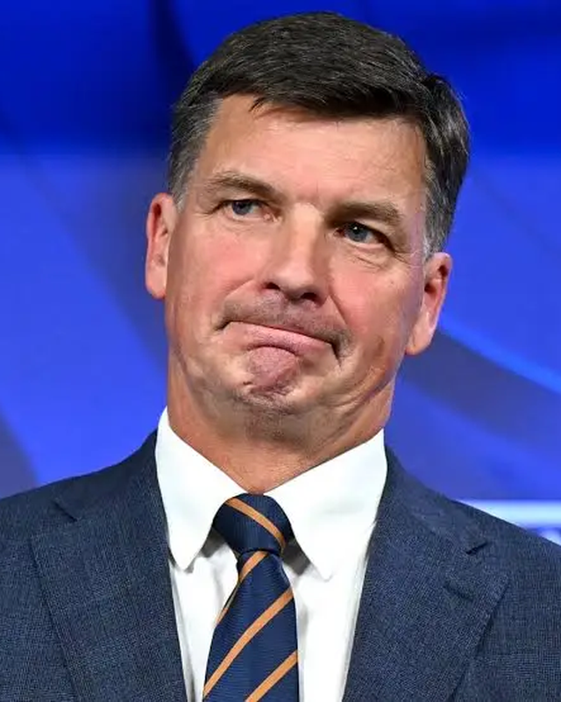
Most know of Angus Taylor. But unimpressed
Q. How much have you seen or heard of Angus Taylor, the Opposition Leader? · How favourable or unfavourable is your opinion of him?
How much they have seen or heard
Opinion of Angus Taylor
A lot
7%
Favourable
32%
Some
30%
Unfavourable
52%
A little
40%
No view / never heard
16%
Nothing at all / unsure
23%
More than half of One Nation voters hold an unfavourable view of the Opposition Leader — and only 7% say they have heard a lot about him.
Both questions asked of all 1,014 One Nation voters, 7–12 August 2026, adjusted for age.
One Nation Voter Study
45

Slide 47
On Taylor, there is potential but almost nothing is strong.
Q. For each statement about Angus Taylor, how much do you agree or disagree? (Asked of the 810 who had seen or heard something of him.)
Strongly agree
Somewhat agree
TOTAL AGREE
UNSURE
Represents traditional Liberal values
6%
49%
55%
22%
Doesn’t understand the pressures on ordinary Australians
17%
33%
50%
14%
Will reduce immigration levels
10%
39%
49%
23%
Is weak and ineffective
12%
32%
44%
17%
Has the policies and ideas for the future
4%
34%
38%
20%
Worth noting just how fragile or soft most views are on Angus Taylor.
One Nation Voter Study
46

Slide 48
The Liberals’ problem, as these voters see it, is the Liberals.
Q. Thinking about the Liberal Party today, do you agree or disagree? Strongly agree, somewhat agree, somewhat disagree, strongly disagree, or unsure?
Strongly agree
Somewhat agree
TOTAL AGREE
UNSURE
The Liberal Party is deeply divided
23%
45%
68%
15%
More interested in fighting each other than taking on Labor
21%
41%
62%
15%
The Liberal Party has no clear policies or direction
18%
41%
59%
14%
One Nation Voter Study
47

Slide 49
About one in four could go back to the Liberals.
Q. How likely is it that a united, credible Liberal Party could win back your vote from One Nation?
27%
THE SOFTER THE VOTE, THE GREATER CHANCE OF RETURNING TO THE LIBS.
How likely each group is to go back to the Liberals
Absolutely certain
to vote One Nation
more than half of all One Nation voters
16%
say a united, credible Liberal Party would be likely to win their vote back
Very likely to,
but not certain
about one in four
35%
"If the Coalition can put forward strong conservative policies and actually follow through with them, I could be tempted to vote for them again."
Man, 35–49, Greater Adelaide
"If the Coalition can stop bickering amongst themselves and deliver stronger policies and show strength, I would look to continue to support them."
Man, 50–64, regional Victoria
Only leaning
towards them
about one in six
43%
Not locked in
at all*
a small group
44%
d
One Nation Voter Study
48

Slide 50
What the Coalition would have to do.
Q. Thinking about the Coalition parties, what policies would they need to introduce to get you interested in voting for them? If nothing would, please say so.
28%
Cut immigration
28%
Nothing, ever
22%
name immigration cuts as what the Coalition must deliver
Cost of living relief
14%
Cut taxes
9%
22% say nothing could interest them — fewer refusals than Labor drew, at 34%.
Fix housing
7%
One Nation Voter Study
49

Slide 51
PART 7
The Nationals and Matt Canavan
What One Nation voters know, and think, of the Nationals' leader
One Nation Voter Study
50

Slide 52
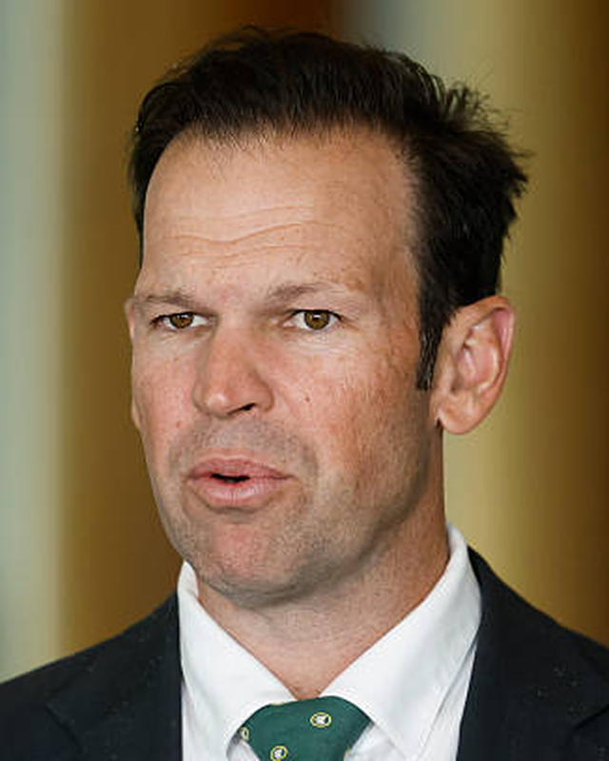
Four in ten have never heard of him.
Q. How much have you seen or heard of Matt Canavan, the Leader of the Nationals?
43%
Nothing at all / unsure
43%
A little
33%
have seen or heard nothing of Matt Canavan, or are unsure who he is
Some
17%
A lot
8%
Recognition is the Nationals’ first problem with these voters — only 8% say they have heard a lot about him.
Asked of all 1,014 One Nation voters, 7–12 August 2026, adjusted for age.
One Nation Voter Study
51

Slide 53
Fossil fuel cut through.
Q. For each statement about Matt Canavan, how much do you agree or disagree? (Asked of the 607 who had seen or heard something of him.)
Strongly agree
Somewhat agree
TOTAL AGREE
UNSURE
Will stand up for coal, gas and mining jobs
26%
38%
64%
21%
Says what he really thinks
21%
40%
60%
19%
Is just another Canberra politician
12%
35%
47%
11%
Is only copying One Nation to win back votes
8%
35%
42%
17%
One Nation Voter Study
52

Slide 54
PART 9
Pauline Hanson
Her standing, what concerns them, and what happens without her
One Nation Voter Study
53

Slide 55
Pauline Hanson has enormous appeal. .
Q. For each statement about Pauline Hanson, how much do you agree or disagree? Strongly agree, somewhat agree, somewhat disagree, strongly disagree, or unsure?
Strongly agree
Somewhat agree
TOTAL AGREE
The praise
Says what a lot of Australians are really thinking
85%
14%
98%
Genuinely cares about the country
79%
18%
97%
Stands up for ordinary, working people
76%
22%
97%
The criticisms
Says things before thinking them through
5%
35%
40%
Would not be taken seriously as a national leader
4%
21%
25%
Is too divisive
2%
16%
18%
One Nation Voter Study
54

Slide 56
PART 8
The One Nation platform
How appealing they find each of the party's own positions
One Nation Voter Study
55

Slide 57
The platform, position by position.
Q. How appealing is each One Nation position to you personally? Very appealing, fairly appealing, neither, not very, or not at all appealing?
VERY
FAIRLY
TOTAL
Substantially reducing immigration
79%
14%
93%
Banning foreign buyers from Australian homes
72%
18%
90%
Getting rid of Welcome to Country
72%
16%
88%
Backing coal, gas and nuclear over renewables
55%
24%
79%
Cutting welfare support for Indigenous Australians
46%
25%
71%
Restructuring the ABC
48%
20%
68%
Ending multiculturalism
45%
23%
68%
Increasing tariffs to protect Australian industry
34%
34%
68%
Making it easier for employers to fire workers
19%
27%
46%
Withdrawing from the United Nations
26%
17%
43%
Cancelling free trade deals
19%
19%
38%
Survey of 1,014 One Nation voters, 7–12 August 2026, adjusted for age. Balance of each row is neither, not very appealing, not at all appealing, or unsure.
One Nation Voter Study
56

Slide 58
Long-term supporters vs. new arrivals.
They bought immigration. They did not buy the rest of it.
Q. How appealing is each One Nation position to you personally? Share saying very appealing — supporters of under twelve months against those of more than five years’ standing.
New — under 12 months
Long-standing — more than five years
GAP
WHERE THEY AGREE — the positions that recruit
Substantially reducing immigration
73%
-16
89%
Banning foreign buyers from Australian homes
68%
-15
83%
Getting rid of Welcome to Country
64%
-15
79%
WHERE THEY PART — the wider programme
Backing coal, gas and nuclear over renewables
44%
-26
70%
Cutting welfare support for Indigenous Australians
38%
-26
64%
Ending multiculturalism
35%
-30
65%
Increasing tariffs to protect Australian industry
31%
-19
50%
Withdrawing from the United Nations
18%
-27
45%
Making it easier for employers to fire workers
16%
-16
32%
Broad, not deep. On immigration and housing the two groups are within four points once fairly appealing is included. On the ideological programme they are twenty-six points apart and the gap does not close.
One Nation Voter Study
33

Slide 59
And they believe it can be delivered.
Q. One Nation has clear, workable plans to actually deliver what it promises. Do you agree or disagree?
87%
Strongly agree
37%
Somewhat agree
50%
agree One Nation has clear, workable plans to deliver what it promises
Somewhat disagree
4%
Strongly disagree
<1%
ONE NATION HAS CLEAR, WORKABLE PLANS
Share who strongly agree
27% of supporters who arrived in the last twelve months
68% of supporters of more than five years' standing
Unsure
9%
One Nation Voter Study
57

Slide 60
Superannuation: “hands off”.
Q. Superannuation was not asked about. It came up unprompted, in answers to other questions — and almost always as something to be defended.
“Stop taxing my super, I haven’t even had a chance to use it yet.”
It is theirs, not the government’s
Super is treated as already-taxed private property. Taxing it is a second bite.
Household’s biggest problem
We are owed it
“We have paid taxes all our lives — do not touch our Superannuation.”
The argument is about what they are owed, not what they lack.
What Labor would need to do
It is about inheritance
“Leave superannuation in the hands of Australians to build generational wealth.”
Death taxes and passing wealth to children recur — this is generational.
What the Coalition would need to do
Both parties are distrusted
The complaint is meddling by Labor and Coalition alike.
21 respondents raised superannuation unprompted; a further 50 raised the age pension — a separate group asking for increases rather than protection.
One Nation Voter Study
58

Slide 61
PART 11
One Nation in government
Whether these voters think One Nation could govern, win, and who it should deal with
One Nation Voter Study
59

Slide 62
One Nation will govern well.
Q. How well do you think One Nation would handle each of these in government? Good job, not so good, or unsure?
% saying One Nation would do a good job
Immigration
93%
Crime
87%
Housing
79%
Cost of living
77%
Defence
73%
Health and education
73%
The economy
70%
Tax
69%
International affairs
61%
One Nation Voter Study
60

Slide 63
But there is a difference between recent arrivals vs the old-timers
Q. How well do you think One Nation would handle each of these in government? Share saying a good job — supporters of under twelve months against those of more than five years’ standing.
New — under 12 months
Long-standing — more than five years
GAP
ONE NATION’S OWN GROUND
Immigration
91%
-4
95%
Crime
84%
-8
92%
Housing
75%
-9
84%
RUNNING THE COUNTRY
Cost of living
71%
-17
88%
Health and education
66%
-21
87%
Tax
65%
-20
85%
The economy
65%
-20
85%
Defence
65%
-21
86%
International affairs
54%
-22
76%
Competence is the soft joint. Only 27% of new supporters strongly agree One Nation has workable plans, against 68% of long-termers — and among new supporters who merely somewhat agree, one in five is at risk of voting elsewhere.
One Nation Voter Study
34

Slide 64
Half believe One Nation can win government outright.
Q. Do you think One Nation can, federally, win enough seats to form government in its own right?
50%
Yes, it can
50%
say One Nation can win enough seats to govern in its own right
No
27%
Unsure
23%
Whatever the electoral mathematics, the belief inside this vote is not that One Nation is a protest vehicle. It is a government in waiting.
One Nation Voter Study
61

Slide 65
If not alone, then with the Coalition — not with Labor.
Q. If One Nation held the balance of power, would you support them going into coalition with the Liberals and Nationals? · And with Labor? · When giving a preference, who would you put ahead — Liberal or Labor?
PREFERENCES
64%
10%
74%
would support a coalition with the Liberals and Nationals
would support a coalition with Labor
would put Liberal ahead of Labor on their own ballot paper
10% oppose
74% oppose
9% would put Labor ahead
One Nation Voter Study
62

Slide 66
PART 10
Trump and Barnaby Joyce
Whether the company she keeps helps or hurts One Nation with its own voters
One Nation Voter Study
63

Slide 67
Trump attracts the hardcore and repels the softs
Q. Pauline Hanson is a strong supporter of Donald Trump. Does that make you more likely to support One Nation, less likely, or does it make no difference?
LESS LIKELY
MORE LIKELY
NET
Strong
6%
35%
+29
certain to vote One Nation (10 out of 10)
Firm
18%
20%
+2
very likely, but not locked in (8–9)
Soft
22%
17%
-5
leaning One Nation (6–7)
Weak*
33%
6%
-27
at or below the midpoint (0–5)
.
One Nation Voter Study
64

Slide 68
Joyce is an asset
Q. Does Barnaby Joyce being part of One Nation make you more likely to support One Nation, less likely, or does it make no difference?
+26
More likely to support
34%
No difference
52%
net effect on support — 34% say more likely, 8% less
Less likely to support
8%
Half say it makes no difference. Unlike Trump, the attraction holds beyond the base: 38% of the most certain voters and 31% of the soft vote say more likely.
Unsure
7%
One Nation Voter Study
65

Slide 69
PART 12
The bottom line
After everything the survey put to them: who stays, who wavers, and where the wavering would go
One Nation Voter Study
66

Slide 70
Ten controversial positions were tested.
Q. Here are some things Pauline Hanson has said. How much, if at all, does each of the following concern you about Pauline Hanson and One Nation? Concerns me a lot, a fair amount, a little, or not at all?
A LOT
A FAIR AMOUNT
TOTAL
Restricting access to abortion
17%
14%
31%
“Domestic violence is a two-way street”
10%
13%
23%
Opposed pay rises for low paid workers
8%
13%
21%
Association with Trump and his circle
10%
10%
20%
“No such thing as a good Muslim”
8%
12%
20%
“Ditching White Australia was a mistake”
6%
10%
16%
Voted against gender pay gap laws
6%
10%
16%
Workers are lazy — make firing easier
5%
11%
16%
Mass deportation of illegal migrants
4%
7%
11%
Gina Rinehart’s $1.3m plane gift
5%
6%
11%
One Nation Voter Study
67

Slide 71
After exposure, 12% of voters left ON.
Q. Considering everything covered in this survey, do you still intend to vote for One Nation, or could you vote for someone else?
12%
Still intend to vote One Nation
88%
could vote for someone else, or were unsure, by the end of the survey
Could vote for someone else
8%
Unsure
4%
This question came last — after ten controversies and every One Nation position had been put to each respondent.
COULD VOTE FOR SOMEONE ELSE
After every criticism and controversy had been put to them
19% of supporters who arrived in the last twelve months
4% of supporters of more than five years' standing
One Nation Voter Study
68

Slide 72
And they would go to Liberals/National.
Q. Who would you be most likely to vote for instead? (Asked of those who said they could vote for someone else.)
41%
Liberal / National
41%
Unsure
24%
of would-be leavers name the Liberals or Nationals
Minor party / independent
16%
Labor picks up 11%. Where this vote is losable, it is losable back to the Coalition it mostly came from.
Labor
11%
Greens
9%
One Nation Voter Study
69

Slide 73
Voters who left were most concerned about:
Q. Here are some things Pauline Hanson has said. How much, if at all, does each concern you? (Among the 12% who could vote for someone else, or were unsure.)
Restricting access to abortion
51%
Opposed pay rises for low paid workers
44%
Association with Trump and his circle
43%
Note: the top four issues, sit within the Labor agenda.
“Domestic violence is a two-way street”
40%
“No such thing as a good Muslim”
39%
Voted against gender pay gap laws
35%
“Ditching White Australia was a mistake”
31%
Gina Rinehart’s $1.3m plane gift
29%
Workers are lazy — make firing easier
26%
Mass deportation of illegal migrants
20%
One Nation Voter Study
70

Slide 74
Doubts about One Nation – in their own words
Q. What is the reason you would no longer support One Nation? Asked of the 12% who said they could vote for someone else, or were unsure.
CAN THEY ACTUALLY GOVERN?
SPECIFIC POLICIES
The biggest doubt — raised by people who like the platform
Four voters named four different objections
“Good at echoing the general feeling of the people, but they lack the right people to run the country.”
“I didn’t know about anti-abortion aspect.”
Man, 35–49, Melbourne
Woman, 65+, Sydney
“Unfair dismissal laws. Leaving the UN.”
“They are populist — I’m not sure how competent they would be in government.”
Man, 35–49, Sydney
Man, 50–64, Sydney
“If they continue to support anti vaxxers.”
Woman, 50–64, Sydney
VALUES AND TONE
HANSON HERSELF
Where the platform runs past them
A live irritant for a handful, not a mass concern
“I just wanted immigration under control. I didn’t fully comprehend the comments put forward by One Nation and Pauline Hanson, which are all against my personal values.”
“Worried about some of her comments I hadn’t heard before. Not so sure of her motives.”
Woman, 65+, Melbourne
Woman, 35–49, regional Victoria
“If Pauline Hanson wasn’t the leader. · Crazy Pauline.”
“If their ideas become too discriminatory.”
Woman, 50–64, Brisbane · Man, 35–49, Melbourne
Woman, 35–49, regional Queensland
Not too extreme — not ready. The most common doubt is about capacity to govern, and it comes from voters who say in the same breath that they like the platform. Several also say the survey introduced them to the concerns — “the issues you have made me aware of here are concerning” — so read this as what a sustained campaign could produce, not what exists today.
One Nation Voter Study
71

Slide 75
PART 12 · THE BOTTOM LINE
Most likely to peel away.
Q. Considering everything covered in this survey, do you still intend to vote for One Nation, or could you vote for someone else?
These things set them apart from the loyal vote.
Female
52% against 36%
Uni Degree
25% against 16%
Not an outright home-owner
67% against 57%
Living on their own
One Nation Voter Study
At risk = could switch or unsure (11.8%, n=122). All three gaps clear the 95% confidence interval.
70

Slide 76
Two of issues have real cut through power to predict a wavering voter.
Q. Running a logistic regression test on each variable while the others are held constant.
no effect
Gina Rinehart’s $1.3m plane gift
×2.8
“No such thing as a good Muslim”
×1.8
Association with Trump and his circle
×1.6
Opposed pay rises for low paid workers
×1.6
Restricting access to abortion
×1.4
“Domestic violence is a two-way street”
×1.3
Voted against gender pay gap laws
×1.2
“Ditching White Australia was a mistake”
×1.2
Mass deportation of illegal migrants
×1.0
Workers are lazy — make firing easier
×0.8
Voters worried about one thing tend to be worried about several. This test asks which concern is doing the work on its own. Eight of the ten do not survive it. The plane gift and the Muslim remark do.
Logistic regression. Base: at-risk voters (n=122) against all ten concern items simultaneously. Figures are odds ratios.
One Nation Voter Study
72

Slide 77
PART 12
The State Scene
One Nation Voter Study
73

Slide 78
At state level the vote holds up — except in Queensland.
Q. Thinking about the state you live in, who would you vote for if a state election were held today? Asked of people who vote One Nation federally.
One Nation
Liberal / National / LNP
Labor
Independent or minor
Greens
Unsure
Queensland
52%
35%
10%
New South Wales
73%
9%
7%
Victoria
76%
14%
Western Australia
70%
10%
9%
9%
South Australia
77%
6%
12%
ALL STATES
69%
16%
8%
One Nation Voter Study
74

Slide 79
PART 13
Where they get their news
The media that reaches One Nation voters
One Nation Voter Study
75

Slide 80
Mainstream first. Fringe barely.
Q. Where do you get your political news? (More than one answer allowed.)
Free-to-air TV news
55%
News websites
38%
Sky News
29%
Newspapers
29%
Word of mouth
28%
ABC / SBS
22%
Facebook
21%
Commercial radio
20%
YouTube
20%
Talkback radio
18%
Podcasts
12%
Instagram
10%
X (Twitter)
10%
TikTok
6%
Survey of 1,014 One Nation voters, 7–12 August 2026, adjusted for age. More than one answer allowed, so figures do not add to 100.
One Nation Voter Study
76

Slide 81
The hard core and the soft ON’ers have different viewing habits.
Q. Where do you get your political news? Comparing the most committed One Nation voters with the softest part of the vote.
MORE USED BY THE SOFT
MORE USED BY THE HARD CORE
Sky News
+16 pts
Facebook
+13 pts
Instagram
+12 pts
Talkback radio
+9 pts
X (Twitter)
+7 pts
ABC / SBS
-7 pts
News websites
-7 pts
Free-to-air TV news
-5 pts
Sky News reaches twice as many of the hard core as the soft edge — 32% against 16%. The part of the vote that is actually winnable is on free-to-air, news websites and the ABC.
One Nation Voter Study
77

Slide 82
The take-outs
1
An older, more Anglo-Australian electorate, male-skewed and culturally traditional — and living outside the capital cities.
2
A Liberal failure as much as a One Nation triumph. Seven in ten voted for another party in 2025, most often the Liberals. This is a fracture on the conservative side of politics.
3
Two issues drive it, and they are linked. Immigration and the cost of living — with immigration increasingly about cultural change, not just numbers.
4
Reactive, but no longer a protest vote. Most arrived within the last two years and beginning to lock into One Nation. Seen as a genuine alternative.
5
The road back is open for the Liberals, but narrow. 27% could be won back by a credible Liberal Party — rising to 43% among the softest part of the vote.
6
Campaignable vulnerabilities — and they are Labor’s ground. Abortion, wages, pay equity and domestic violence sit on Labor’s agenda, and concern is highest among soft supporters. Labor’s opening to peel away part of this vote.
7
The Liberal dilemma. Winning these voters back will mean moving towards One Nation — and changing the character of the Liberal party itself.
Survey of 1,014 One Nation voters, 7–12 August 2026, adjusted for age.
One Nation Voter Study
78

Slide 83
Thank you.
The One Nation Voter Study — a national survey of 1,014 One Nation voters, August 2026.
For further information
John Utting
Managing Director, Utting Research
john@uttingresearch.com
0414 428 846
One Nation Voter Study

